Slide 1
Big Mountain Resort
Pricing Strategy:
Optimizing ticket price
Proposing most profitable changes to resort features

Slide 2
Recommendations
Increase ticket price in the direction of target price of $97.96 (conservatively $87.6)
Four most important resort features for supporting higher ticket price
Run number
Fast quad number
Area with snow machines
Vertical drop height
Consider dropping least-used runs (proposal #1), increasing vertical drop (proposal #2)

Slide 3
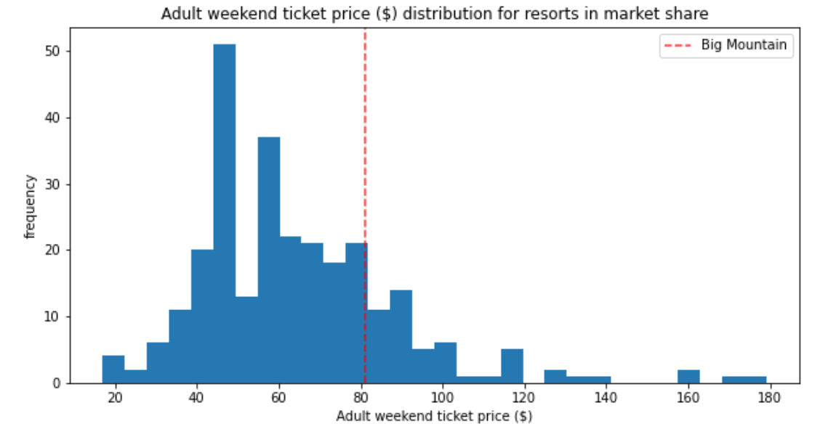
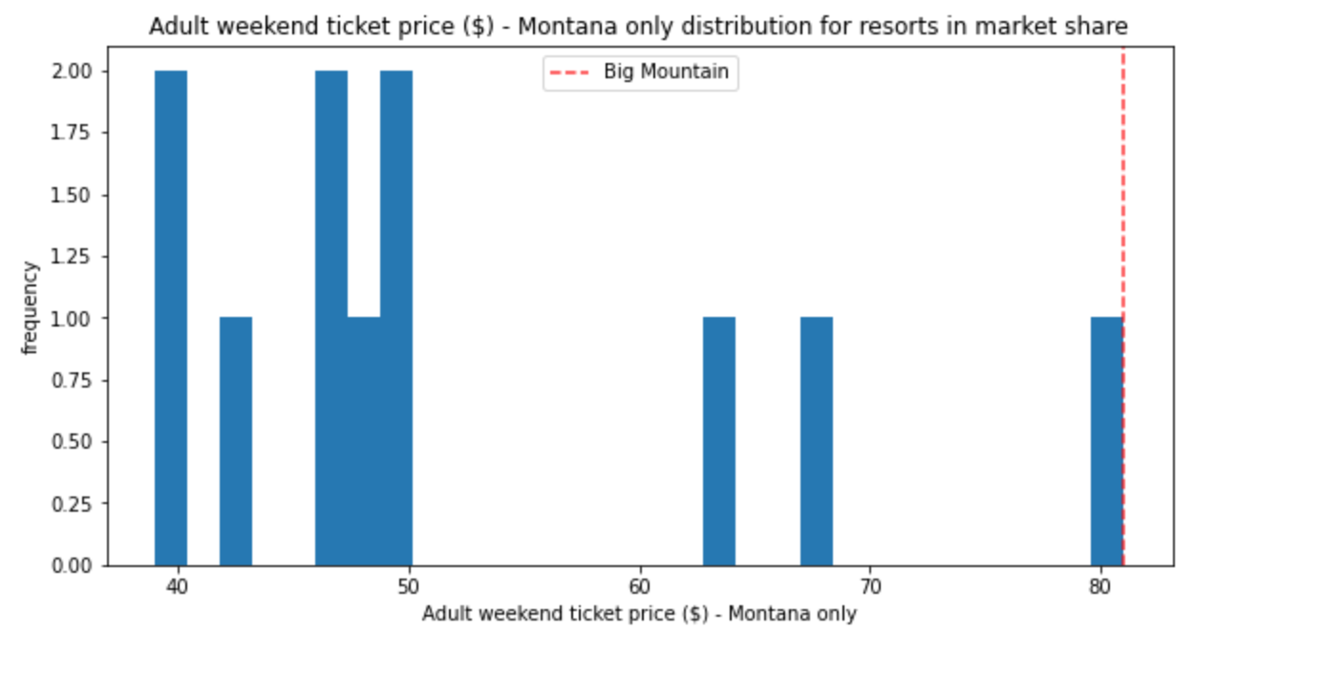
Market segment ticket prices
Though Big Mountain is the most expensive resort in Montana, it has room to grow within its market segment

Slide 4
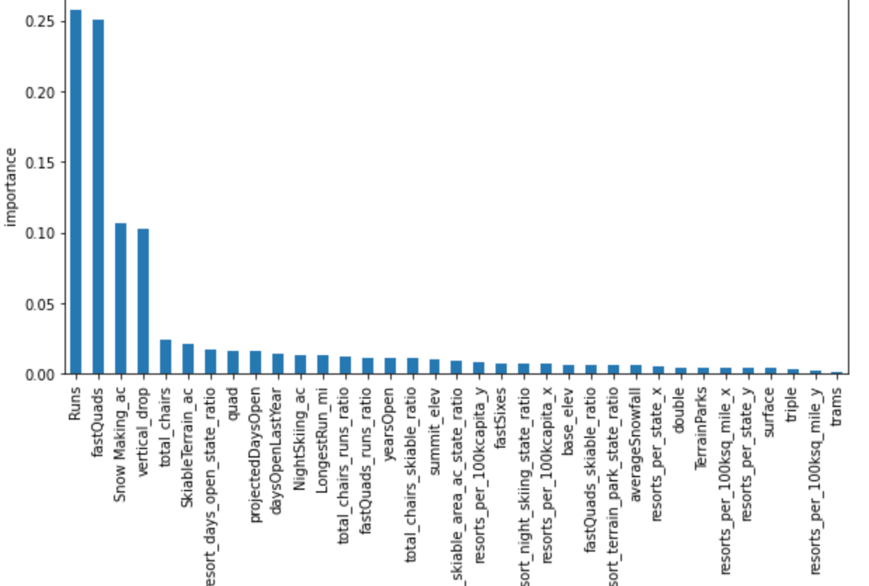
Most important resort features supporting higher ticket price
Big Mountain has among the highest in the four most important categories, except for vertical drop, where there is still room for growth

Slide 5
Most promising proposals
Proposal #1: Permanently closing down up to 10 of the least used runs. This doesn't impact any other resort statistics.
One run can be closed without affecting ticket price support
Further closures will affect price support but not linearly – further investigation required
Proposal #2: Increase the vertical drop by adding a run to a point 150 feet lower down but requiring the installation of an additional chair lift to bring skiers back up, without additional snow making coverage
Increases support for ticket price by $7
Over the season this could be expected to amount to $12,250,324

Slide 6
Conclusion
There is definite room for growth in ticket pricing
Our model predicts an ideal ticket price based on resort features of $97.96 with a mean average error of $10.37
There is room for growth from our current price of $81 even when accounting for model error
We should further investigate proposals #1 and #2 in order to increase ticket price support levels
Need more data on operating costs to make definite recommendations on those proposals

